Slide 1
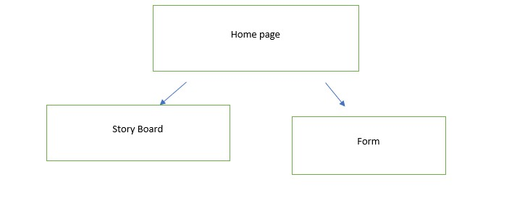
Site plan
My site plan isnt much. It just shows
That the home page leads to the story board amd form.

Slide 2
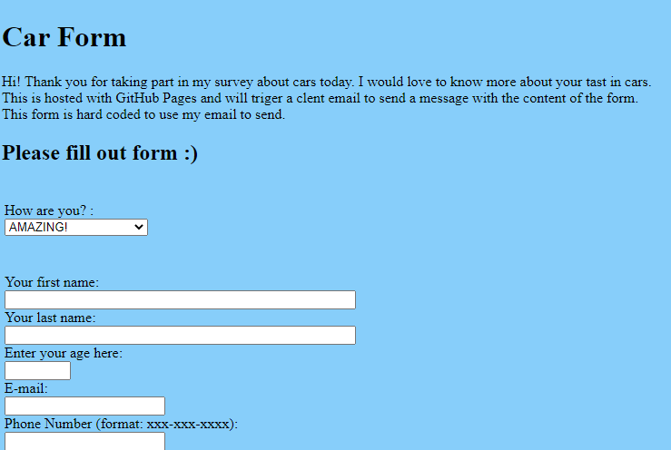
Contrast, Reptition, Alignment, and Proximity
I have been using CRAP to make my websites look better. In my forms I used

Slide 3


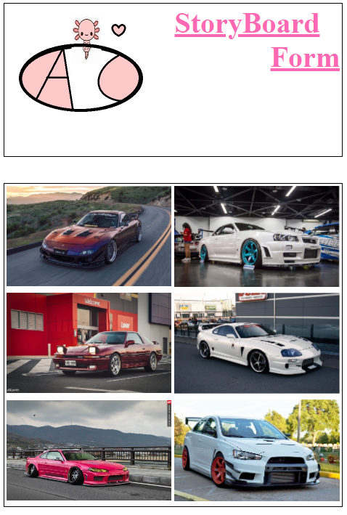
CSS code allowed the hyper links to change colors to Pink but when you hover over it its blue.
Using tables in CSS made my life a lot easier when adding photos into the website.

Slide 4
Aidan's future cars (aidancain13.github.io)

